Slide 1

Specialization
Dotnet Core 6.0 with Architecture
C# 9.0, WPF 4.5 .2 with Blend
ASP.Net Core 6.0 , Micro services
WCF 4.5.1, Web API, WF 4.5.1
Advanced Python, Django, Flask
Python network Automation, ML & AI
Micro-frontend ,MEAN & MERN stack
UML 2 and OOAD, DDD
HTML 5, CSS 3, SASS, Bootstrap
65 .Net Design Patterns
ES 6, Jquery 3.x,D3.js,YAML,JSON
Aurelia, Post CSS, Lost Grid, AMD
Typescript, Angular 16
Vue js, Oracle Jet, Open UI 5
Gatsby js, Metal js,
React 18.x & Redux , React native
Ext JS 6, Backbone ,Kendo UI
Node js, Mongo DB & Restify
Mocha, Jasmine,Protractor, Karma
Docker, Webpack, Grunt, Gulp,
React & React native with Redux
Dr. D.S.R.Murthy
Software Architect & Corporate Trainer
Experience : 31 years
https://www.educba.com/what-is-react-native/

Slide 2
React native with Redux
By Dr. DSR Murthy

Slide 3
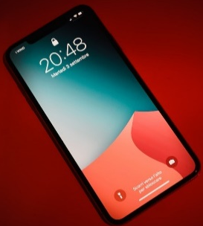

Hybrid Application Development

Slide 4
Hybrid Application Development
There are over 6.5 billion smartphone users across the world and it is forecasted to further grow to 7.6 billion by 2027.
Statistics reports says that the worldwide mobile application revenues have risen dramatically throughout the past two years from 255.5 billion in 2019 to 420.7 billion in 2022.
It is one of the most profitable industries, the growth rates are increasing rapidly, and as more and more people own smartphones, the market is expanding.

Slide 5
Hybrid Application Development
What’s everyone doing on their mobile phones?
88% of mobile time is spent on apps. The app percentage continues to increase year over year. The vast majority of time spent on a mobile device is spent connected to the internet.
This is exciting news for app developers, app publishers, and anyone who plans on developing an app.

Slide 6
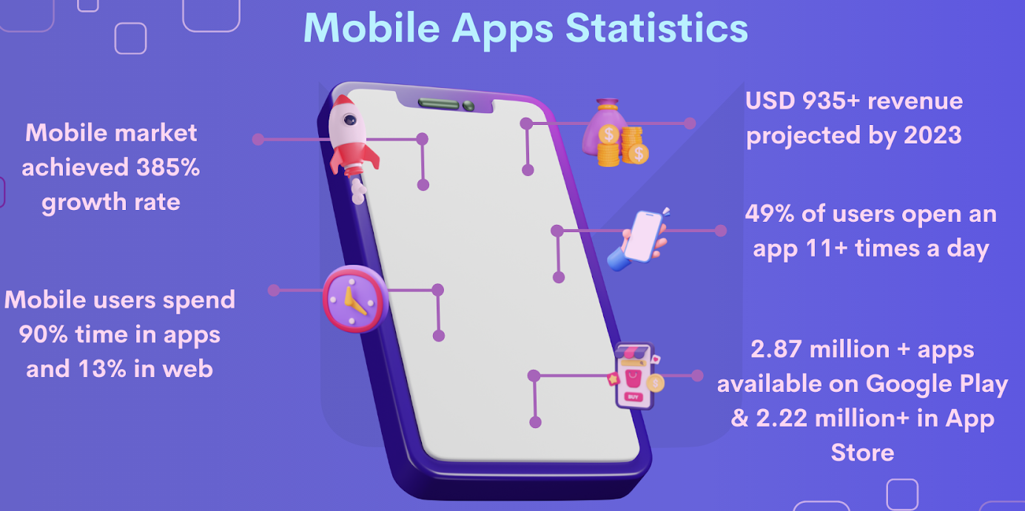
Hybrid Application Development

Slide 7
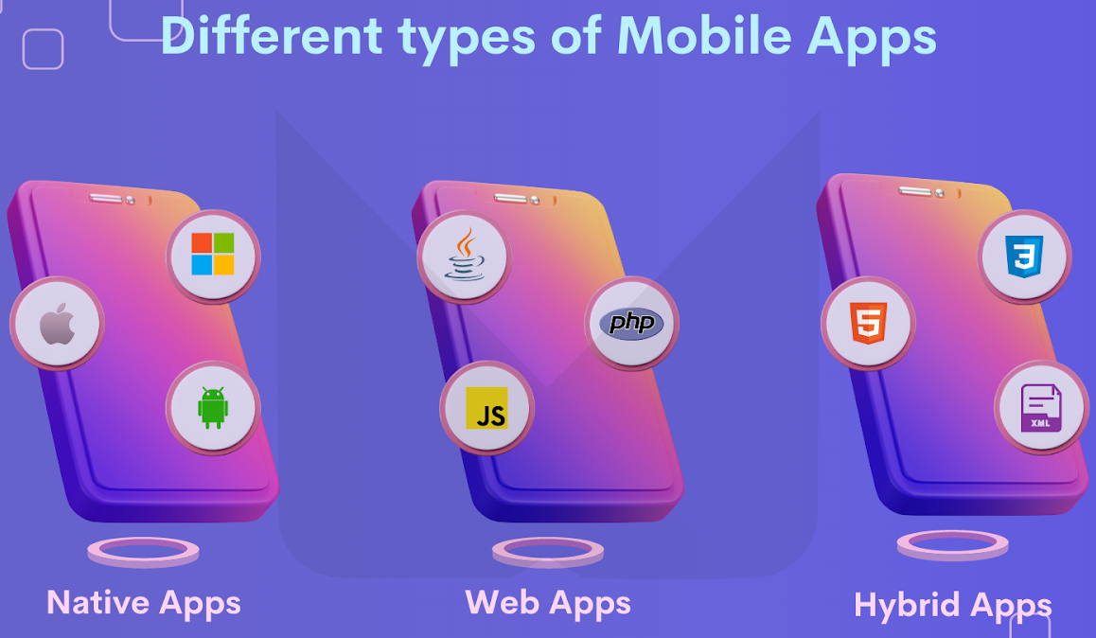
Hybrid Application Development

Slide 8
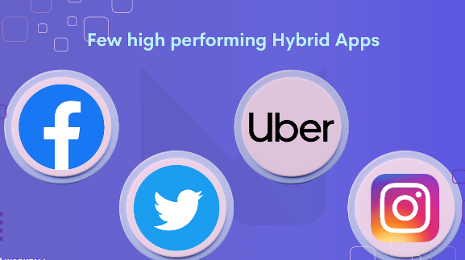
Hybrid Application Development
Hybrid App
The production of a single software that can run on several operating platforms, such as Windows, Android, and iOS, is known as hybrid app development.
Hybrid development adopts an approach to writing the code once and runs it everywhere to build an app.
Hybrid apps, like native apps, are available through app stores, can access hardware on phone, and are installed on device.
It is built with web technologies, which means millions of web developers already have the base skillset to build mobile apps. (HTML, CSS, javascript & React with Redux)

Slide 9
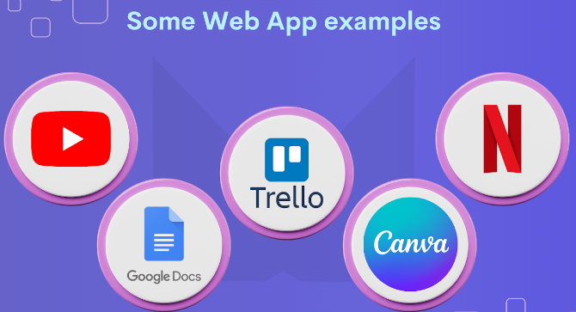
Hybrid Application Development
Web App
Web App
A Web application is a program stored on a remote server and delivered over the internet through a browser interface.
It behaves similar to native apps, they’re not standalone apps in the sense of having to download and install code device. They’re actually responsive websites. (react application)
A web application reduces costs for both the end-user and the business. Because updates are applied centrally, web applications are constantly up to date. Because all users have access to the same version, there are no compatibility difficulties.

Slide 10
Hybrid Application Development
Progressive web app (PWA)
Web App
A progressive web application, commonly known as a PWA, is a type of application software delivered through the web, built using common web technologies including HTML, CSS, JavaScript, and WebAssembly.
PWA offers the look and feel of an app but is accessible via a web browser. They’re improved with APIs to deliver more features beyond standard web apps.

Slide 11

Hybrid Application Development
Native app (PWA)
Web App
What is a Native App?
A native mobile app is a smartphone application written in a programming language particular to the platform, such as Java for Android. Native mobile apps have a high level of performance and dependability.
Native apps have the advantage of being faster and more dependable in terms of performance due to their solitary focus. They use the device’s resources more efficiently than other sorts of mobile apps. It utilizes the native device UI, giving users a more optimized customer experience.

Slide 12
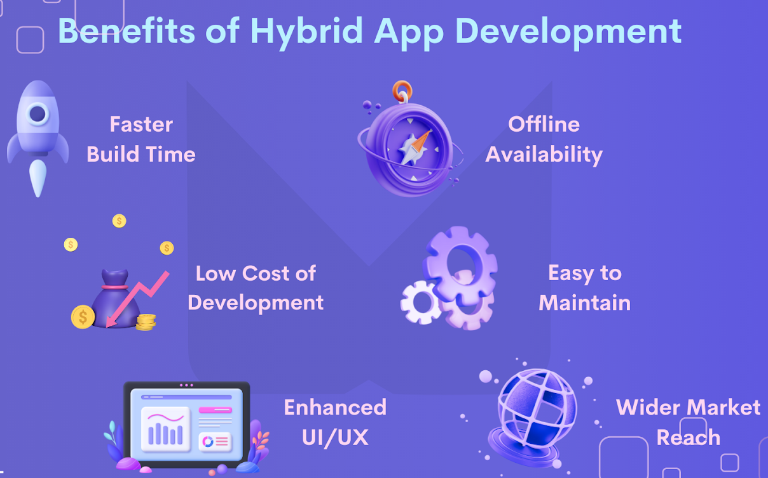
Hybrid Application Development
Advantages of hybrid apppp
What is a Native Apps?
Hybrid mobile apps cost less than native ones and also takes less time to create them and it is easier to manage them.

Slide 13
Hybrid Application Development
Advantages of hybrid app
Faster Build Time: Since there is one codebase to manage the application, it takes less time to build a hybrid than native apps.
Low Cost of Development: Hybrid mobile apps cost less than native apps. Due to the fact that developers write one set of code for all the operating systems.
Wider Market Reach: Because hybrid apps use a single codebase, they can be deployed across devices. For example, when we build them for Android, we can easily launch them on iOS.
Offline Availability: Hybrid mobile apps will work in an offline mode due to their native infrastructure. Users can still load the programme and see previously loaded data even if they can’t access real-time data.
Enhanced UI/UX: It offers a consistent and flawless user experience across iOS and Android platforms.
Easy to Maintain: Hybrid mobile app development offers simplified maintenance. A hybrid app eliminates versioning and makes app management as simple as updating a web page, that too in real-time.

Slide 14
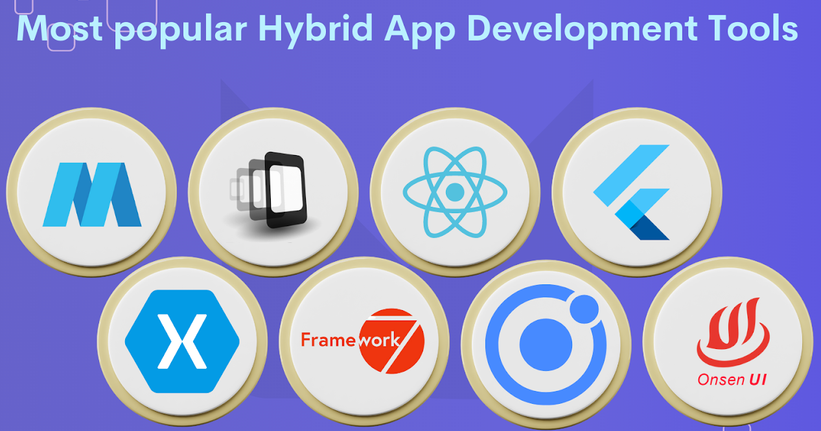
Hybrid Application Development

Slide 15
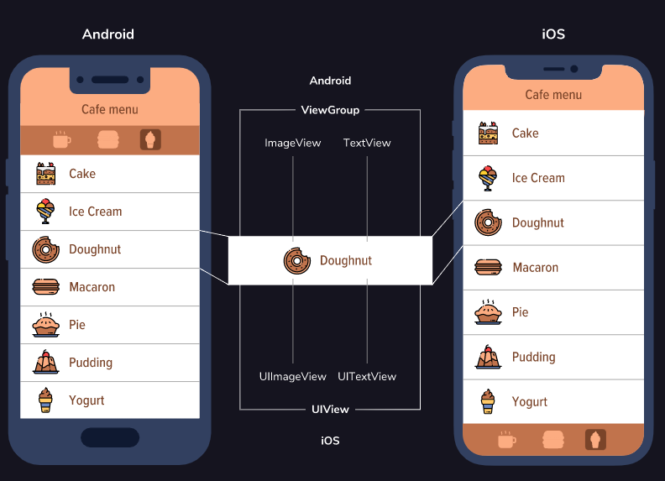
What is React-native
React Native is a library built with the same API as React.
React native supports all the features of react like props/state, components, component life cycle methods, hooks, context api and redux state management library integration.
It uses the same declarative UI paradigm but renders directly to native components. Write app once in React and run it on multiple native platforms, like Android and iOS.

Slide 16
What is React-native
React Native will use Hermes, an open-source JavaScript engine optimized for React Native.
If Hermes is disabled, React Native will use JavaScriptCore, the JavaScript engine that powers Safari. Note that on iOS, JavaScriptCore does not use JIT due to the absence of writable executable memory in iOS apps.
When using Chrome debugging, all JavaScript code runs within Chrome itself, communicating with native code via WebSockets.
Chrome uses V8 as its JavaScript engine.
.

Slide 17
Why Hermes?
Hermes is an open-source JavaScript engine optimized for mobile. It starts quickly, is small in size, and has low memory usage - all great features for something running on a mobile device.
All of these design factors will result in improved start-up time, decreased memory usage, and smaller app size.
The purpose is to use built-in JavaScript engine for React Native that makes app work better and use less resources.
Kotlin
Now Kotlin is the official language for Android App Development declared by Google in 2019.
Kotlin is a cross-platform programming language that may be used as an alternative to Java for Android App Development.
Gradle: a tool to build android and ios native apps.

Slide 18
Type of libraries / frameworks
React Native: It’s one of the most well-known frameworks for hybrid mobile apps. It’s capable of creating stunning mobile apps for both iOS and Android. App developers don’t have to start from scratch when using React Native. It uses building elements from the Android and iOS platforms to create cross-platform mobile apps that are effective.
Flutter: Flutter from google enables developers to construct highly productive apps for Android and iOS using a single codebase.
Ionic: Ionic is an HTML5 mobile app framework that focuses on developing hybrid apps.
Mobile Angular UI: It is made up of two well-known web app frameworks: Bootstrap and Angular. Both contain UI components that aid in the creation of a top hybrid mobile app in the same way that a web app does.
PhoneGap: PhoneGap is an Adobe System software development framework for creating mobile applications. To create apps with PhoneGap, the developer simply has to know web-development languages like HTML, CSS, and JavaScript, not a mobile programming language.
Xamarin: It provides software development tools that allow users to create apps for Android, iOS, and Windows using the C# programming language and the.NET framework. The.NET Framework is the foundation of Xamarin.

Slide 19
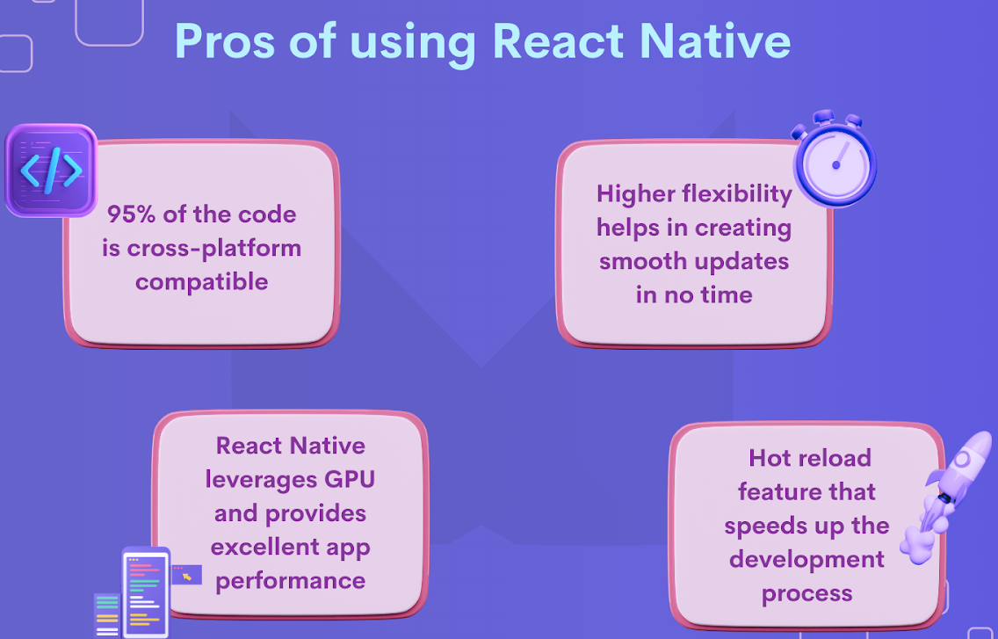
React native

Slide 20
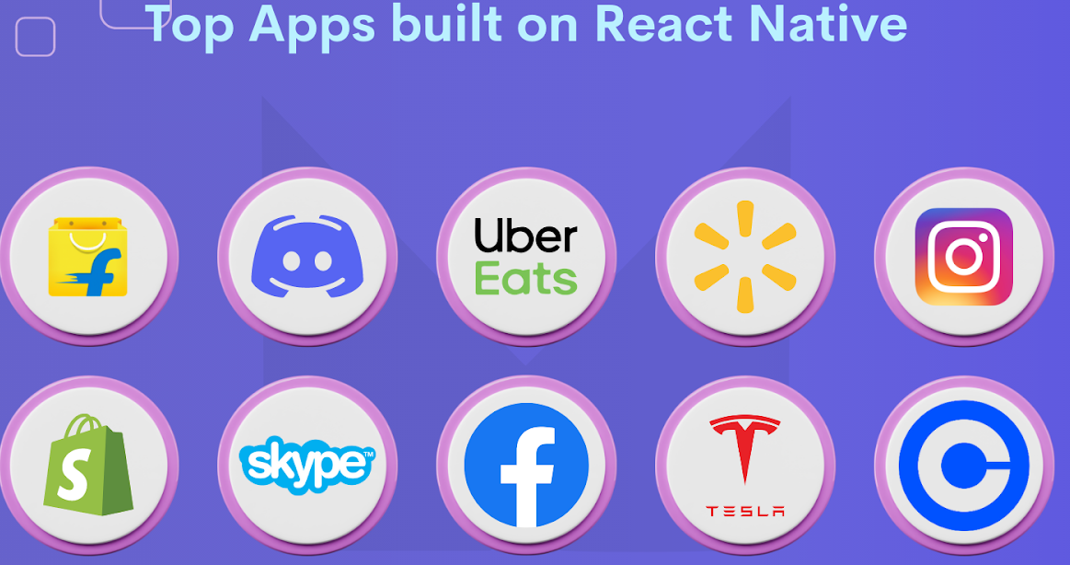
React native

Slide 21

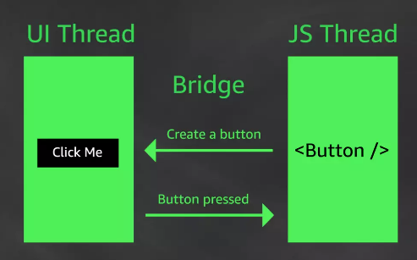
React Native

Slide 22
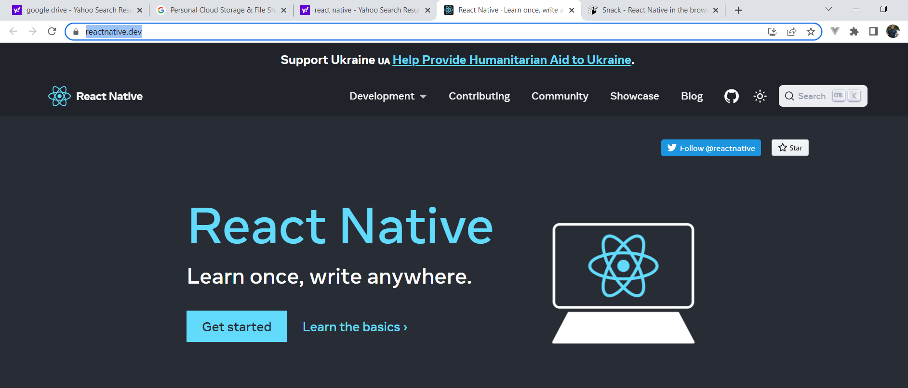
React Native
Visit : https://reactnative.dev/ for learning with example code.

Slide 23

Expo & React Native
Expo is a platform to make universal React apps that helps to develop, build, deploy, and quickly iterate on mobile apps.
It provides a range of tooling to make development with React Native even easier.
Although Expo isn’t required to create React Native apps, it helps developers by removing the need for basic native knowledge.
Expo Go is an app. Download on mobile phone to “view” app in development.
Expo CLI is a tool to create, manage, and develop apps.
npm install –g expo-cli
Expo SDK is a modular set of packages that provide access to native APIs, like Camera or Notifications.
Expo Snack is a web-based playground to write React Native snippets and run them in the browser. https://snack.expo.dev/

Slide 24
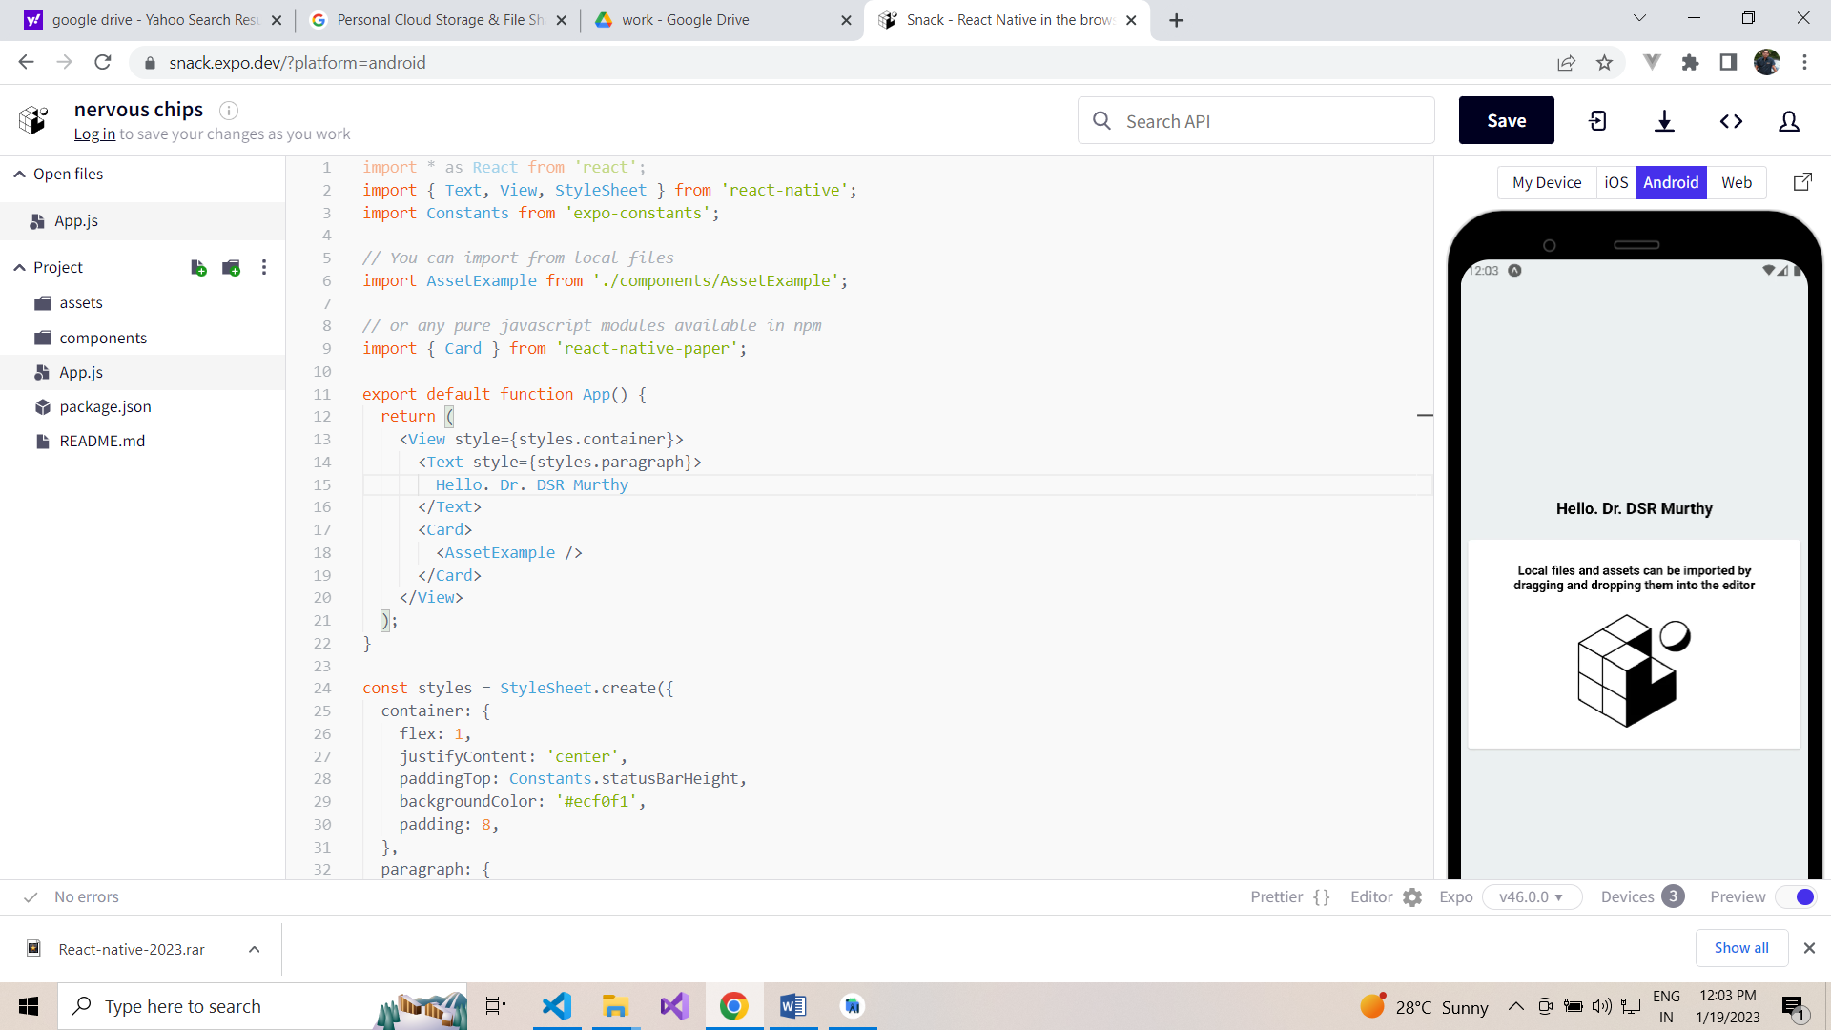
Expo & React Native

Slide 25
Should I use Expo and React native?
Expo and React Native provide a comprehensive framework with a big community.
For most apps, Expo and React Native are a good choice:
Apps built with Expo or React Native can run on multiple platforms. That means faster development and less code to maintain while sharing most of the code.
It provides direct access to native functionality, allowing developers to make the app as performant as pure native apps.
Getting started with Expo and React Native only requires basic web development and basic native platform understanding.
Big companies like Bloomberg, Shopify, and Coinbase are using React Native for their mobile apps. Coinbase started with native and moved to React Native with great success.

Slide 26
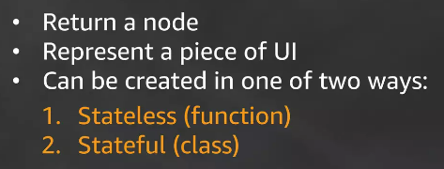
React-native Component
All apps in Expo and React Native are made out of components.
These components are small reusable pieces of app, all working together.
Each of these components has a single responsibility.
Component renders all other components in app, from screens to simple text. Instead of rendering this component to DOM, Expo and React Native renders it using the entry point. (AppEntry) like index.js

Slide 27
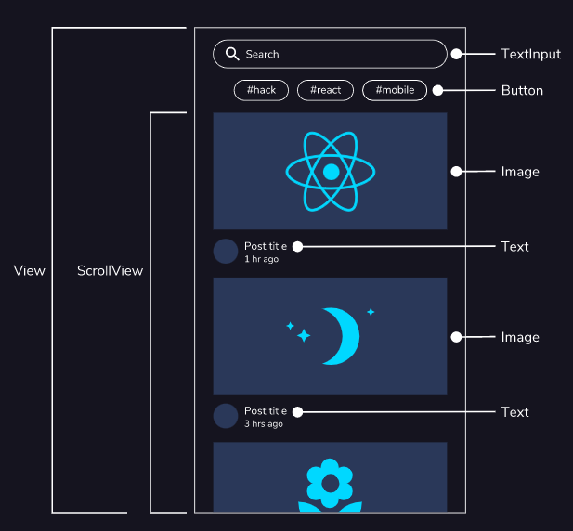
React-native Component

Slide 28
React Native component
import React from 'react';
import { Text } from 'react-native';
const App = () => (
<Text style={{ margin: 64 }}>
Welcome to React Native!
</Text>
);
export default App;

Slide 29
Native rendering
React native has Core components like <Text>.
The JavaScript with the components is bundled in app and executed in a separate thread from the native UI. This JS thread instructs React Native what it needs to render. Splitting this into a JS thread and a UI thread allows the platform to understand what needs to be rendered without blocking the actual interface components.
Besides the visible UI components, the native UI thread is also handling native API requests. Some functionality, like GPS location, needs to be requested from the native APIs. If JS code uses this kind of functionality, it interacts with the native API using native code. The data from this native code is sent back to the JS code and handled in app.

Slide 30
Summary
React Native is a library that uses React for mobile app development to create performant apps with JavaScript.
Expo is a platform for universal React apps that contains React Native and helps you iterate fast, without any native platform knowledge.
Components in React Native have a native component counterpart that is rendered on the native platform.
Expo and React Native runs React JavaScript in the actual app, in a different thread from the UI to keep app running smoothly.
Just like React, Expo and React Native uses the entry point of app to render it on different native platforms.
Because different native platforms aren’t identical, some components behave differently on some platforms.

Slide 31
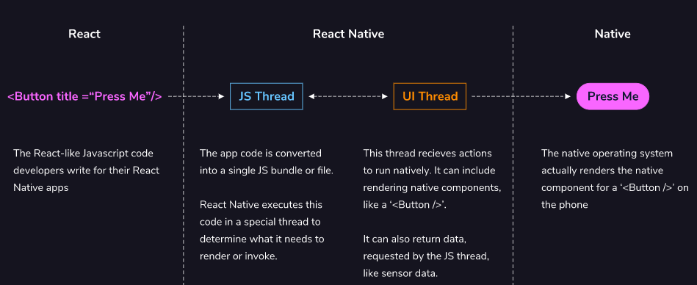
Native rendering

Slide 32
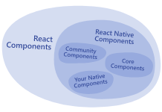
React Components

Slide 33
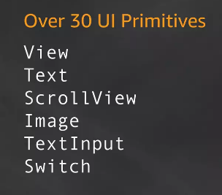
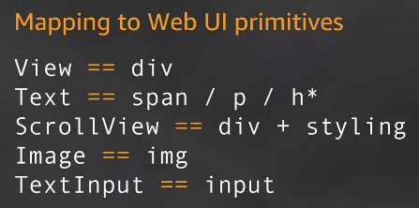
React Native API

Slide 34
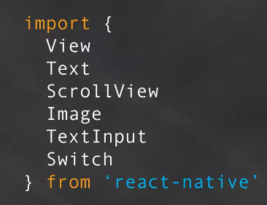
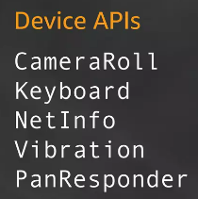
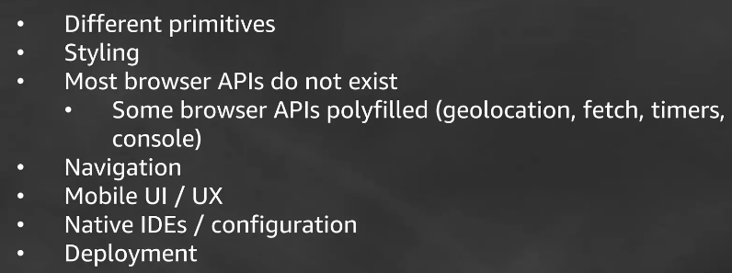
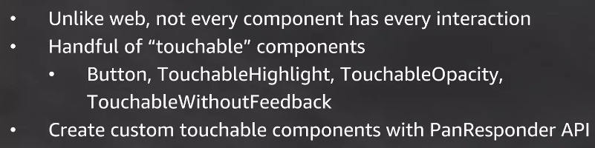
React Native API
React native vs web

Slide 35
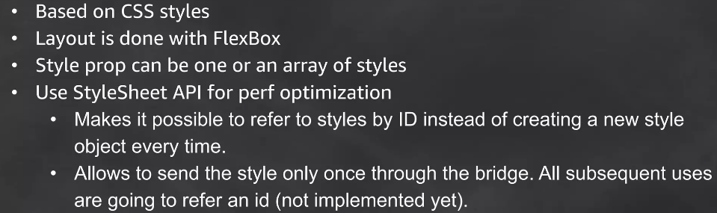
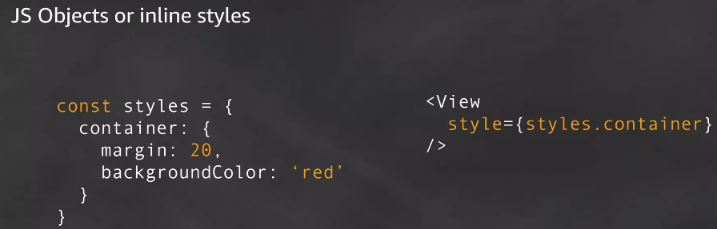
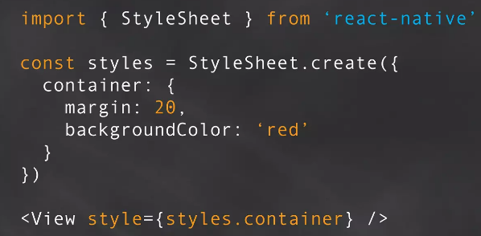
React Native
React native vs web

Slide 36
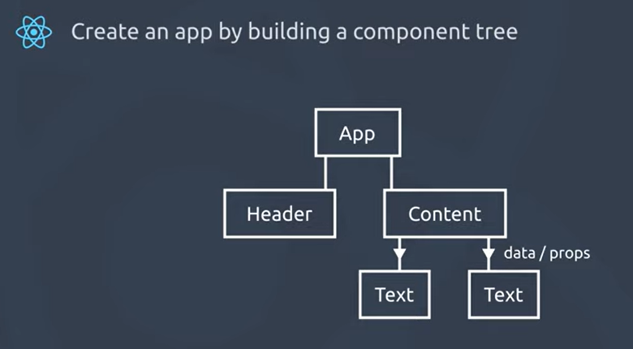
React Native API

Slide 37
Setup
Install Nodejs 16.x
To create project react-native
$ npm install -g create-react-native-app
$ create-react-native-app rnapp
$ cd rnapp
$ npm run web or npm start
To create project with expo
$ npm install -g expo-cli
$ expo-cli init myapp
$ cd myapp
$ yarn run web or yarn start
Install jdk15.x
Set java_home path for jdk
Install Android studio
Add nexus6p with pie version for emulator

Slide 38
Visit for documentation
https://reactnative.dev/docs/intro-react

